Slide 1

Icon Library
Icons
Copy and paste icons from this slide to where it’s needed.

Slide 2

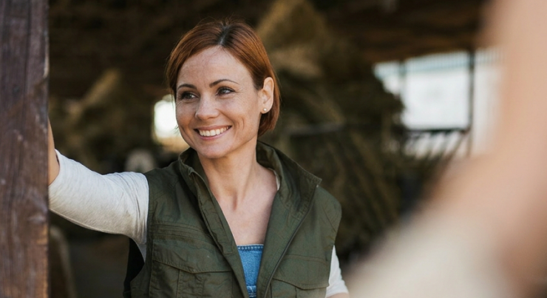
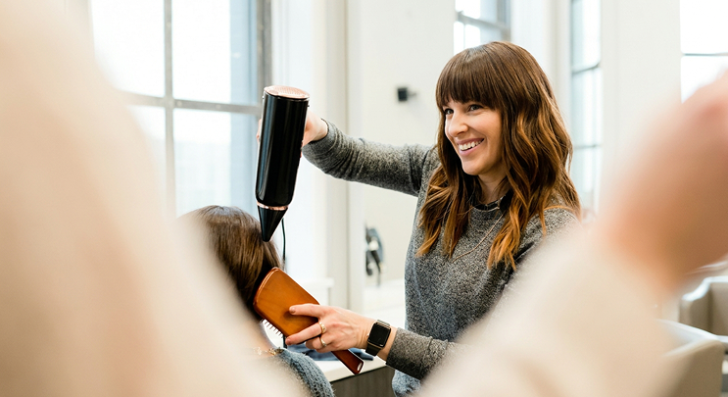

Photography style
Photography
Our photography follows the same principle as the rest of the brand: observed rather than performed.
Subjects look off-camera. Light falls naturally, usually from a window. Foregrounds blur into atmospheric mass — a colleague's shoulder, the edge of a workbench — framing the subject as if witnessed.
The register is editorial documentary, not corporate or staged. Real moments, gently warmed in color, slightly desaturated. The viewer feels like they walked in mid-conversation.

Slide 3
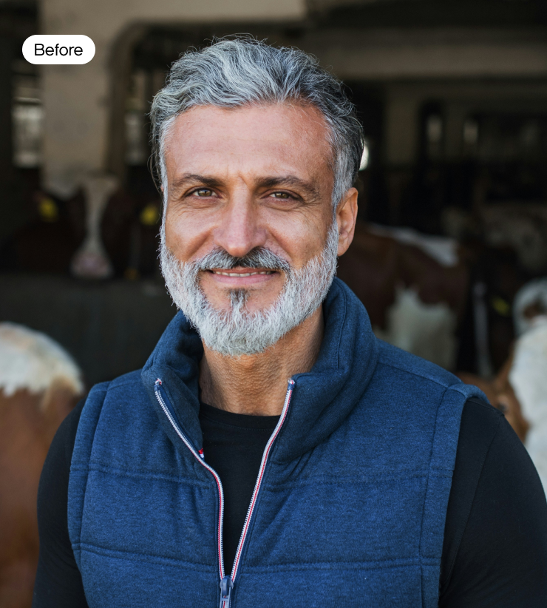
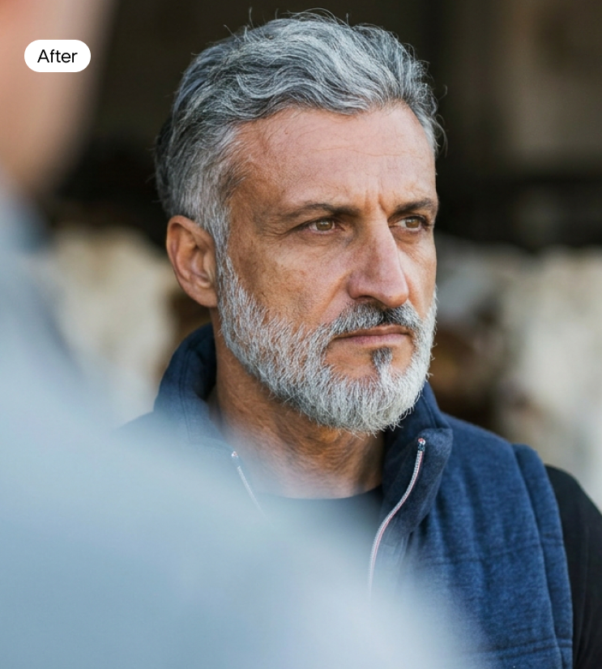
Photography style
Transformation prompt
Most source photography we use is transformed to match our visual language.
The prompt anchors lens behavior (135mm at f/1.2), foreground bokeh, and our split-tone color grade. The result is a consistent series register — warm honey-peach highlights, cool neutral shadows, soft film texture — applied across different photographers and source conditions.
Prompt:
”Editorial documentary photograph, 135mm f/1.2, razor-thin depth of field. Subject sharp, looking off-camera, naturally lit, original face lighting preserved. Extreme foreground blur — a real physical object or person inches from the lens, dissolved into a soft tonal mass, no texture, no edges, no detail. Foreground on the opposite side from the light source. Color grade: warm honey-peach highlights, gently warm midtones, slightly cool neutral shadows — a film-emulation split-tone treatment like Kodak Portra 400 with a warm push, or Fujifilm Eterna. Skin tones lean warm peach. Saturation reduced by 10-15%, soft rolled highlights, lifted shadows with preserved detail, slightly muted overall. Not sunset, not golden hour — daylight with a warm grade layer. Film grain, natural skin texture. Editorial magazine register. Saul Leiter — heavy abstract foreground bokeh, beautifully lit subject. Photorealistic.”
Preferred model: Nano Banana 2 (w/ Extended Thinking enabled)

Slide 4


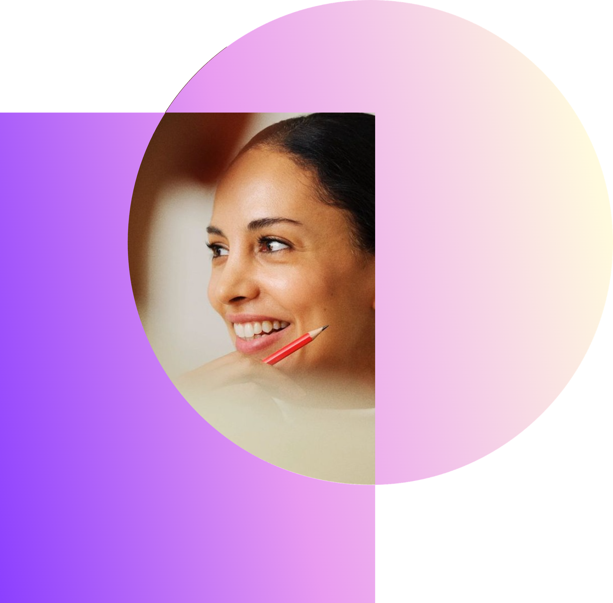
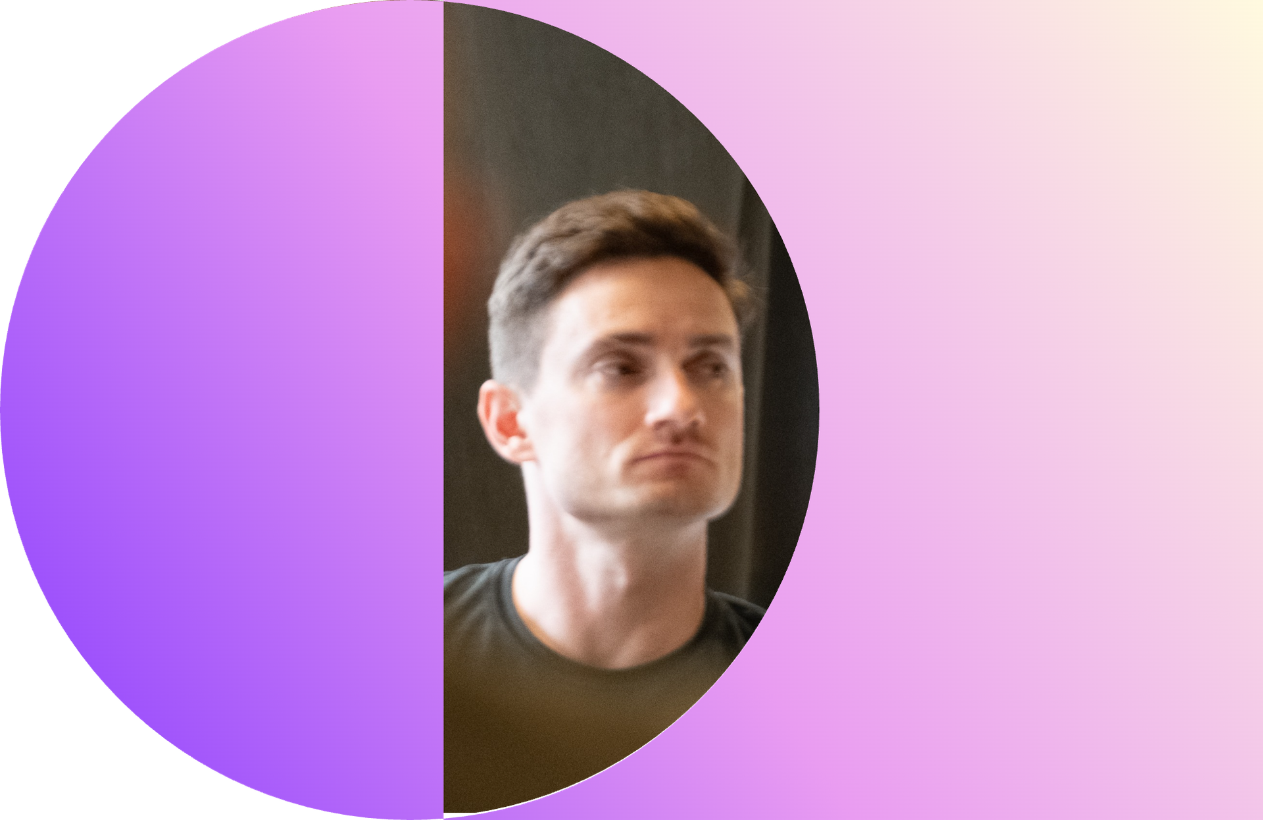
Brand pattern
Image mask
The pattern can act as a frame for photography, treating images as objects within the overlapping field.
Used this way, the pattern brings brand identity into photographic compositions without overwhelming the image. The shape carries the brand; the photograph carries the story.
Reserve this treatment for editorial moments, campaign visuals, and brand-led content. It is not a default treatment for all imagery.
Go to brand.done.ai/pattern-image-mask to add your own images to the brand pattern mask and download it.
Once you have downloaded the file, you can easily replace any of the image frames in the following slides by right-clicking and change/replace, ensuring placements and size stays consistent.

